Slide 1

A Hybrid Recommendation System Considering Visual Information for Predicting Movies
FYP Defense Presentation By BSCS-F23-016
03-134202-035 | MUHAMMAD ABDULLAH JAVED
03-134202-010 | ANNAS BIN KHALIL

Slide 2
CLO Mapping
CLO | PLO | Description | Specified Aspects
CLO1 | PLO3:Problem Analysis | Analyze the given problem to propose a computing-based solution. | Analyzing limitations of existing systems and formulating hybrid solutions
CLO2 | PLO4:Design and Development of Solutions | Design and develop computing solutions to complex computing problems. | Designing a scalable hybrid recommendation system
CLO3 | PLO5:Modern Tool Usage | Demonstrate the ability to use modern tools to solve the given problem. | State-of-the-art tools like ALS, Python, VGG-16, Google Colab, Flask
CLO4 | PLO6:Individual and Team Work | Demonstrate the ability to work effectively as an individual and a team member. | Individual: Personal Reports, Reflection Journal, Individual Presentation Team Work: Report Collaboration, Project Management
CLO5 | PLO10:Life Long Learning | Understand the significance of broader aspects of innovation, potential legal implications, and development. | Innovation: Novel Hybrid Algorithm Legal Implications: Data Privacy Development: Applied Advanced Machine Learning Algorithms
CLO6 | PLO7:Communication | Demonstrate effective skills in verbal and written communication during presentations, discussions, and reports. | Written: Produced Detailed Reports that accurately describe objectives, methodology and results. Discussion: Team Meetings with Supervisor, Conveying Ideas effectively

Slide 3
Abstract
Movie recommendation systems enhance user engagement
Current methods face scalability and popularity bias issues
Hybrid algorithm integrates ALS and CNN
VGG16 used for image feature extraction
Improved accuracy and user satisfaction achieved
Achieved RMSE of 0.8315

Slide 4
What (CLO-1/PLO-3)
Develop a hybrid recommendation system
Integrate collaborative and content-based filtering
Enhance recommendation accuracy and diversity
Provide personalized movie recommendations
Improve user satisfaction and platform performance

Slide 5
Why (CLO-1/PLO-3)
Current systems lack personalization
Collaborative filtering ignores item attributes
Content-based filtering ignores user preferences
Improve accuracy and diversity of recommendations
Address scalability and popularity bias issues

Slide 6
How (CLO-1/PLO-3)
Combine collaborative filtering with content-based filtering
Use ALS for matrix factorization
Apply VGG16 for image feature extraction
Integrate and sort results with cosine similarity
Evaluate performance using RMSE, MAE, MAPE, and MSE

Slide 7
“Words alone can be ambiguous, but images provide the clarity to understand their true context”

Slide 8
Objectives
Develop a hybrid movie recommendation system
Address scalability issues and popularity bias
Incorporate contextual information like movie posters
Enhance accuracy beyond user-item interactions
Ensure diversity and consider niche preferences

Slide 9
Deliverable and Beneficiaries
Following are the deliverables
Website
Hybrid Algorithm
Following are the beneficiaries
Movie Enthusiasts
Streaming Platforms

Slide 10
Scope [1/2]
Problem Description
Limitations of traditional methods:
Scalability issues
Popularity bias
Lack of diversity and personalization
Insufficient contextual information

Slide 11
Scope [2/2]
Proposed Solution
Develop a hybrid algorithm:
Combines collaborative filtering (ALS)
Uses content-based filtering with CNNs (VGG-16)
Feature extraction from movie posters
Integrate features with collaborative filtering

Slide 12
Literature Review [1/2]
Paper | Methodology | Algorithms | Results / Findings
Image Based Recommender System using Transfer Learning [1] | 1. Uses VGG-16 to extract product features | SVD, VGG-16 | RMSE: 1.67
A Lightweight Model of VGG-16 for Remote Sensing Image Classification [2] | Remote sensing image features Remove redundant information Classify images | VGG-16 | Accuracy: 94%
Matrix Factorization+ for Movie Recommendation [3] | Model for movie recommendations using visual features Incorporating low-level and high-level visual features | SVD++ and ResNet50 | RMSE: 0.87

Slide 13
Literature Review [2/2]
Paper | Methodology | Algorithms | Results / Findings
Improved Hybrid Deep Collaborative Filtering Approach for True Recommendations [4] | 1. Proposed different methods. LSTM, TF-IDF | CNN, LSTM, TF-IDF | Rating to determine the movie popularity is not reliable and significant
A picture is worth a thousand words: Introducing visual similarity into recommendation [5] | Measures the probability between items that are similar in terms of visual effect or “styles” | KNN, SVD | Indicates that visual information can be considered as a reliable feature in recommending process

Slide 14

Methodology [1/6] (CLO-2/PLO-4)
Collaborative Filtering
Technique used in recommendation systems to predict user preferences
Based on the assumption that users who agreed in the past will agree in the future
ALS Algorithm
Goal
Factorize the user-item interaction matrix 𝑅 into two lower-dimensional matrices
User matrix 𝑈 (users' latent factors)
Item matrix 𝑀 (items' latent factors)
Equation

Slide 15
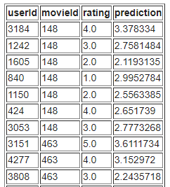
Methodology [2/6] (CLO-2/PLO-4)
ALS Process:
Initialization
Start with random matrices 𝑈 and 𝑀
Alternating Optimization
Fix 𝑀, solve for 𝑈 (minimize squared error + regularization)
Fix 𝑈, solve for 𝑀 (minimize squared error + regularization)
Iterate until convergence

Slide 16
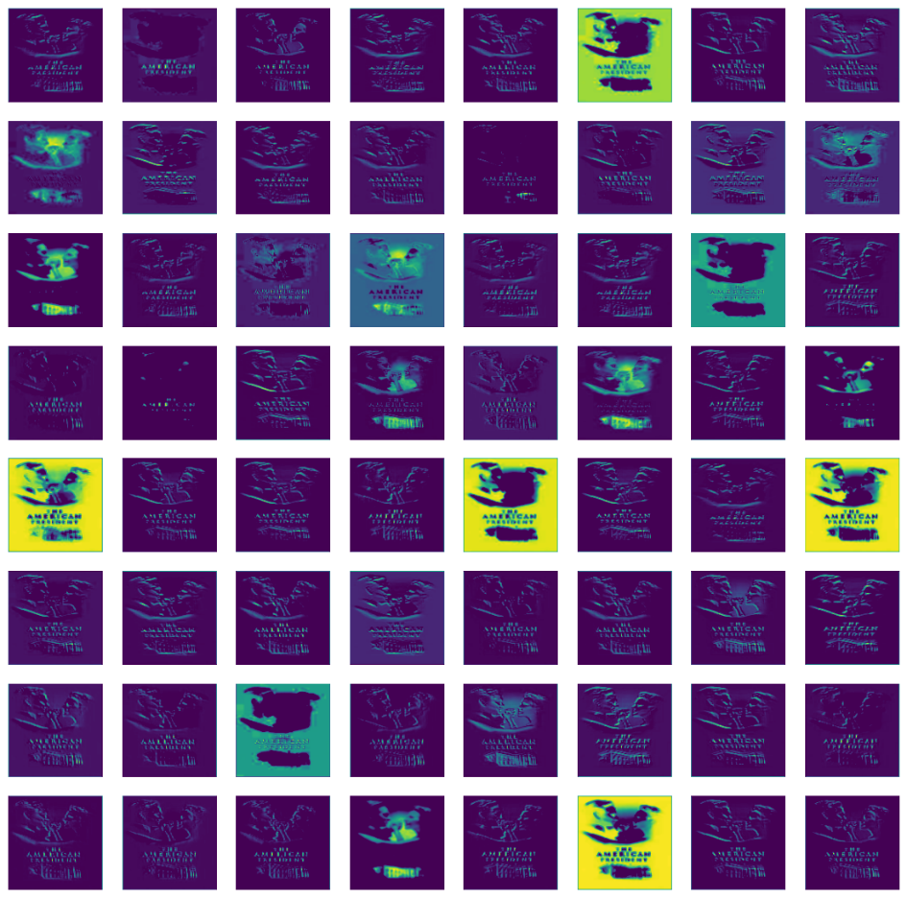
Methodology [3/6] (CLO-2/PLO-4)
Image Poster Feature Extraction
VGG-16 is a pioneering convolutional neural network (CNN) architecture
VGG-16 applies convolutional filters to movie posters
Extracts high-level visual features such as textures, edges, and patterns

Slide 17
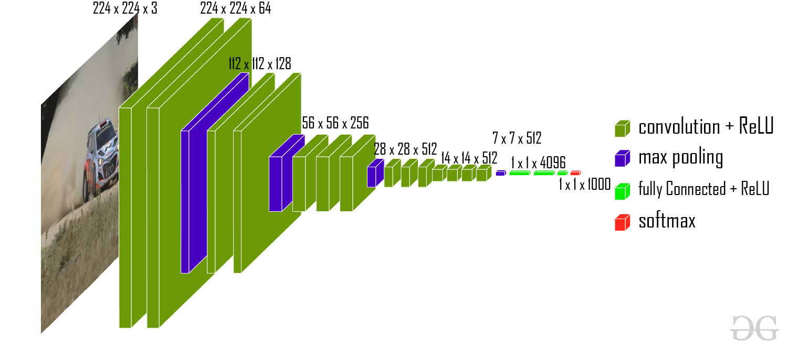
Methodology [4/6] (CLO-2/PLO-4)
VGG-16 Architecture

Slide 18
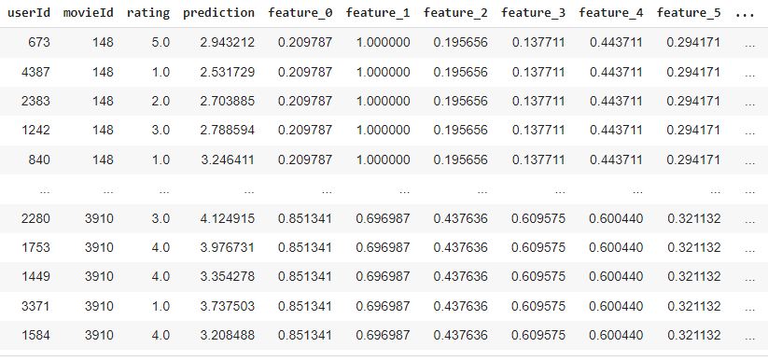
Methodology [5/6] (CLO-2/PLO-4)
Combining ALS Results with Poster Features
Merge based on MovieId
Bridge the gap between CBF and CF

Slide 19
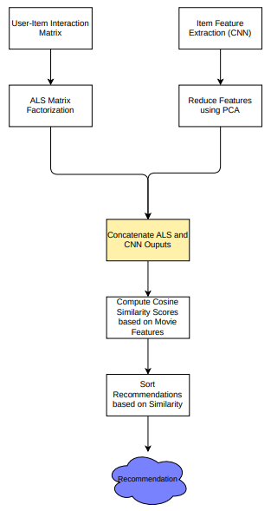
Methodology [6/6] (CLO-2/PLO-4)
System Architecture
Recommendations generated by both components are combined
Ensures that users receive personalized recommendations

Slide 20
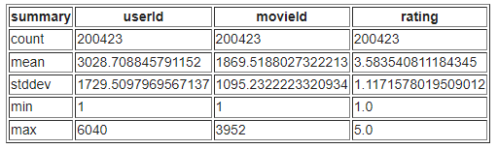
Data and Experiments
Data Sources
Movielens
Kaggle (Movie Posters)
Preprocessing
Replace movie poster names with movieId
Remove low rated movie records
Remove duplicate posters
 | MLP-1M | MLP-20M
Posters | 3816 | 26,940

Slide 21
Data and Experiments
Hybridization Experiments
Approaches Explored
Manual selection and sorting based on cosine similarity scores
Linear regression on combined collaborative filtering and content-based features
Manual Selection Method
Combining movie poster features based on movie ID
Sorting recommendations based on cosine similarity
Linear Regression Approach
Creating a predictive model to learn the relationship between collaborative filtering scores and content-based features

Slide 22
Data and Experiments
Hybridization Experiments
Evaluation Results
Manual sorting based on cosine similarity yielded the best results in terms of recommendation accuracy and user satisfaction
Linear regression approach showed potential but yielded lower performance compared to manual sorting

Slide 23
Results and Discussion
Performance Metrics
Root Mean Squared Error (RMSE)
Average magnitude of the errors between predicted and actual ratings
Mean Absolute Error (MAE)
Average absolute difference between predicted and actual ratings
Mean Absolute Percentage Error (MAPE)
Percentage difference between predicted and actual ratings
Mean Squared Error (MSE)
Average squared difference between predicted and actual ratings

Slide 24
Results and Discussion
 | ALS | SVD | Hybrid Approach
RMSE | 0.8821 | 0.8773 | 0.8315
MAE | 0.708 | 0.6888 | 0.6648
MSE | 0.7779 | 0.7697 | 0.6914
MAPE | 25.7437 | 26.5834 | 14.7669

Slide 25
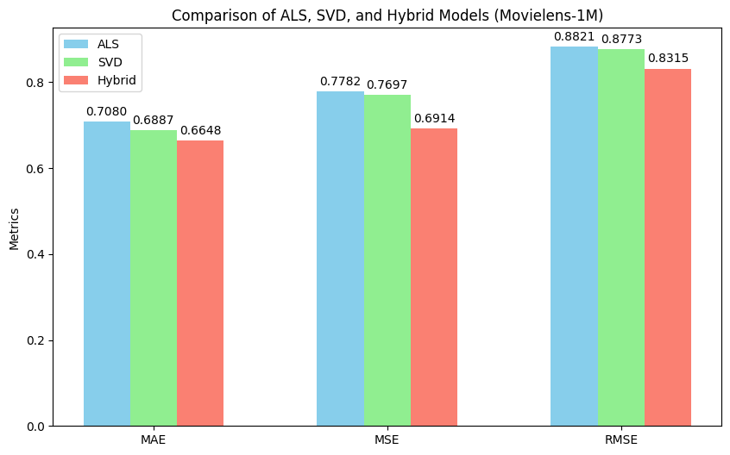
Results and Discussion

Slide 26
Results and Discussion
Impact of Hybridization Techniques
Improved Accuracy BUT
Needs large computational power
Very time consuming to generate recommendation
Techniques to optimize
Prevent re-computation
Lower dataset size
Use Parallel Processing

Slide 27
Tools & Techniques (CLO-3/PLO-5)
Python: Programming Language
Flask: Web Framework
Apache Spark: Handling large scale dataset
Web Scrapping: Poster Collection
PCA: Reduce the dimensionality of extracted features
Google Colab: Used for Primary Development
Matplotlib and Seaborn: Used for Visualization

Slide 28
Conclusion
The hybrid recommendation system combining CBF and CF proved highly effective
Superior recommendation accuracy, diversity, and personalization were achieved compared to baseline methods
Evaluation metrics consistently showcased the system's superiority across various criteria, validating its efficacy

Slide 29
Recommendations
Increase Movie Poster Dimension and Quantity
Integrate NLP techniques to further add text-similarity
Implement parallel processing and distributed computing techniques
Iteratively refine and enhance the system based on user feedback

Slide 30
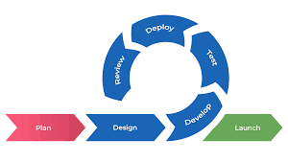
Software Development Model

Slide 31
References
[1] Singh, Nikhil Kumar and Abhimanyu Kumar. “Image Based Recommender System using Transfer Learning.” 2022 2nd International Conference on Emerging Frontiers in Electrical and Electronic Technologies (ICEFEET) (2022): 1-4.
[2] Ye, Mu et al. “A Lightweight Model of VGG-16 for Remote Sensing Image Classification.” IEEE Journal of Selected Topics in Applied Earth Observations and Remote Sensing 14 (2021): 6916-6922.
[3] Zhao, Lili et al. “Matrix Factorization+ for Movie Recommendation.” International Joint Conference on Artificial Intelligence (2016).
[4] Ibrahim, Muhammad & Sarwar, Imran & Sarwar, Nadeem & Waheed, Haroon & Hasan, Muhammad Zulkifl & Hussain, Muhammad Zunnurain. (2022). Improved Hybrid Deep Collaborative Filtering Approach for True Recommendations. Computers, Materials and Continua. 74. 5301-5317. 10.32604/cmc.2023.032856.

Slide 32
References
[5] C. Guo, M. Zhang, Y. Liu and S. Ma, "A picture is worth a thousand words: Introducing visual similarity into recommendation," 2016 Seventh International Conference on Intelligent Control and Information Processing (ICICIP), Siem Reap, Cambodia, 2016, pp. 153-160, doi: 10.1109/ICICIP.2016.7885893.

Slide 33
A Hybrid Recommendation System Considering Visual Information for Predicting Movies
Thanks
Please feel free to:
Ask any further details
Advise any improvements
FYP Defense Presentation By BSCS-F23-016
03-134202-035 | MUHAMMAD ABDULLAH JAVED
03-134202-010 | ANNAS BIN KHALIL

